Slide 1

Pedestrian Detection
By,
Arjun Veeramachaneni
Campus ID – CH95135

Slide 2
Index :
Introduction
Previous Work
Implementation
Conclusion

Slide 3
Introduction
The goal of this project is to localize humans in static images.
It is a challenging problem for many reasons.
There are various descriptor methods such as SIFT, etc.
Feature computation was done after running the images on intersection kernel SVM classifier.
Notes:
People having wide variety of poses, distinct appearance and clothing.
Haar
HOG

Slide 4
Previous Work
SIFT’s approach allows to extract distinctive invariant features from the object we are trying to detect.
Detection is done by matching feature key-points in a testing image to a dictionary of key-points extracted from training images for the object that we are trying to detect.
Another method is the Belongie’s Shape Context approach.
Dalal and triggs used histograms of oriented gradients(HOG) as a template descriptor for human detection.
Notes:
consists of sampling the edges of the object into points of interest, and capturing the distribution of the sampled points on the shape with respect to a given point on the shape

Slide 5
Implementation :
Created folder consisting of single and multiple pedestrian images.
Initialize the non max suppression parameters.
Considered a detector with a stride of 8X8 and varied block sizes.
A window size of 64X128 was taken.
Now we compute features over the scalespace and create sampling grid.
We compute the gradients of the image.

Slide 6
The next step is that we normalize the image and concatenate the features of the image.
We now run these features using our precomputed classifier.
A threshold of 0 is given, so it considers all the indexes with the value greater than 0.
We then carried out the non max suppression in order to minimize the cluster effect and to bound the box around the person.
Finally the score is computed and displayed above the bounded box .

Slide 7
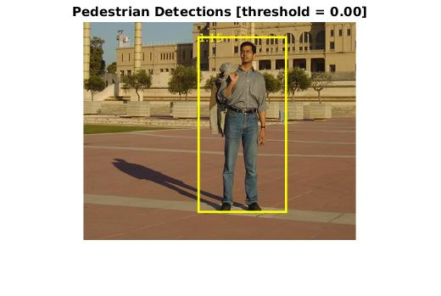
Single Pedestrians

Slide 8
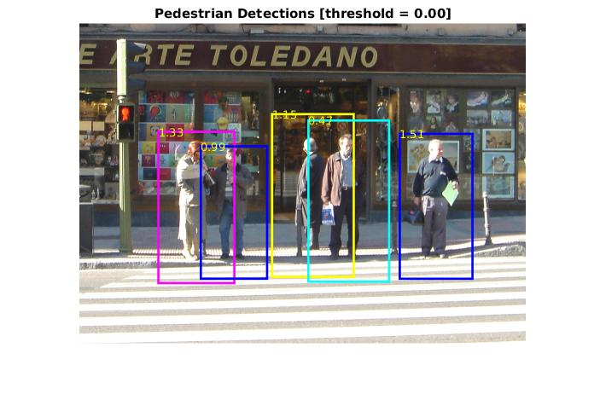
Multiple Pedestrians

Slide 9
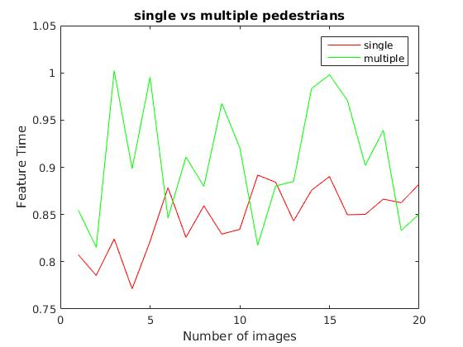

Slide 10
Conclusion :
We see that by computing the features human detection works well when used in conjunction with Intersection Kernel SVM classifier.
Finding the correct scale for detection is a little tricky.
Also there are some images where the detection doesn’t happen, we cannot be sure or tell exactly what the reason could be.
The detection also tends to generate false positives on elements with strong vertical components such as architectural elements, trees, poles.

Slide 11
Thank you

